Slide 1
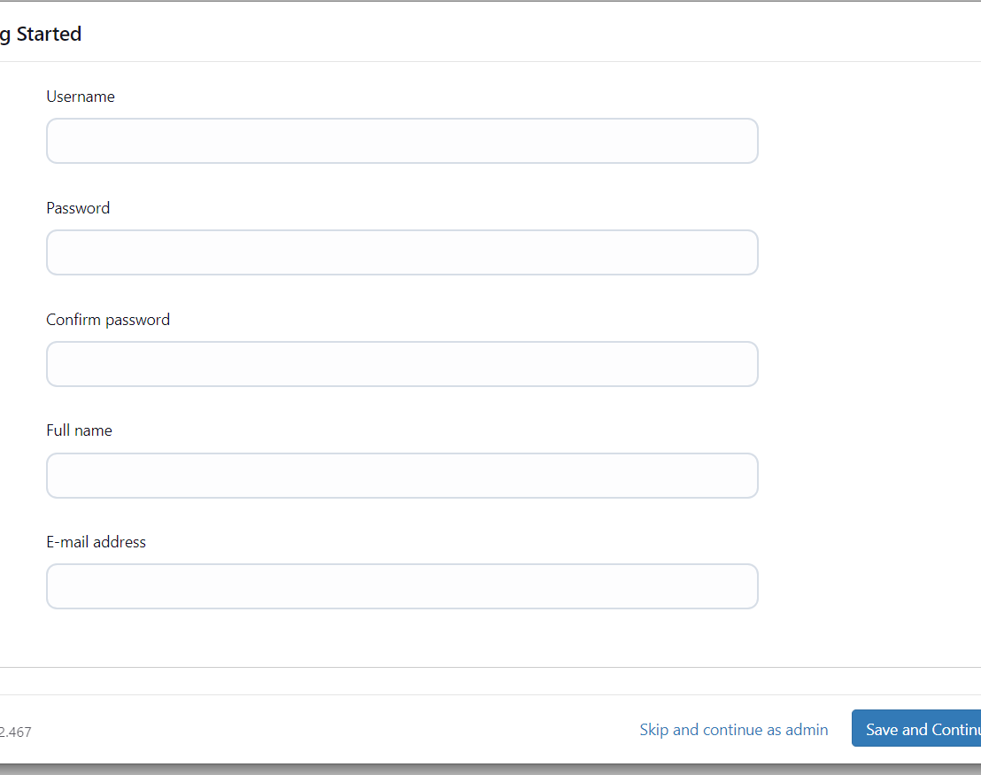
Installing Jenkins
Setting up the Jenkins from
sudo apt update
sudo apt install openjdk-11-jreec2 Instance
java –version
curl -fsSL https://pkg.jenkins.io/debian/jenkins.io-2023.key | sudo tee \
/usr/share/keyrings/jenkins-keyring.asc > /dev/null
echo deb [signed-by=/usr/share/keyrings/jenkins-keyring.asc] \
https://pkg.jenkins.io/debian binary/ | sudo tee \
/etc/apt/sources.list.d/jenkins.list > /dev/null
sudo apt-get update
sudo apt-get install jenkins

Slide 2
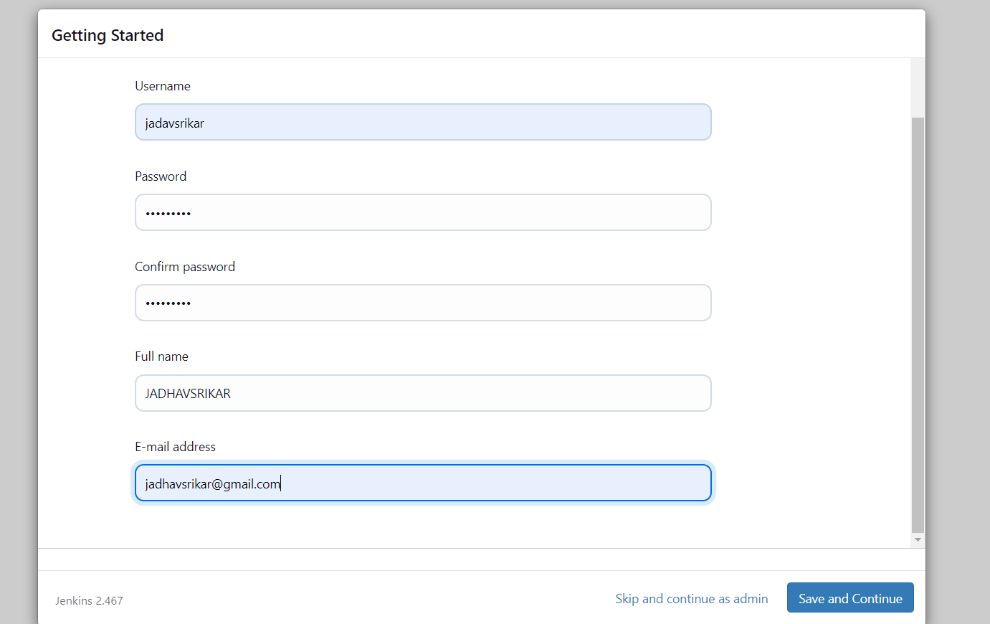
EC2 > Instances > Click on
In the bottom tabs -> Click on Security
Security groups
Add inbound traffic rules as shown in the image (you can just allow TCP 8080 as well, in my case, I allowed All traffic).

Slide 3
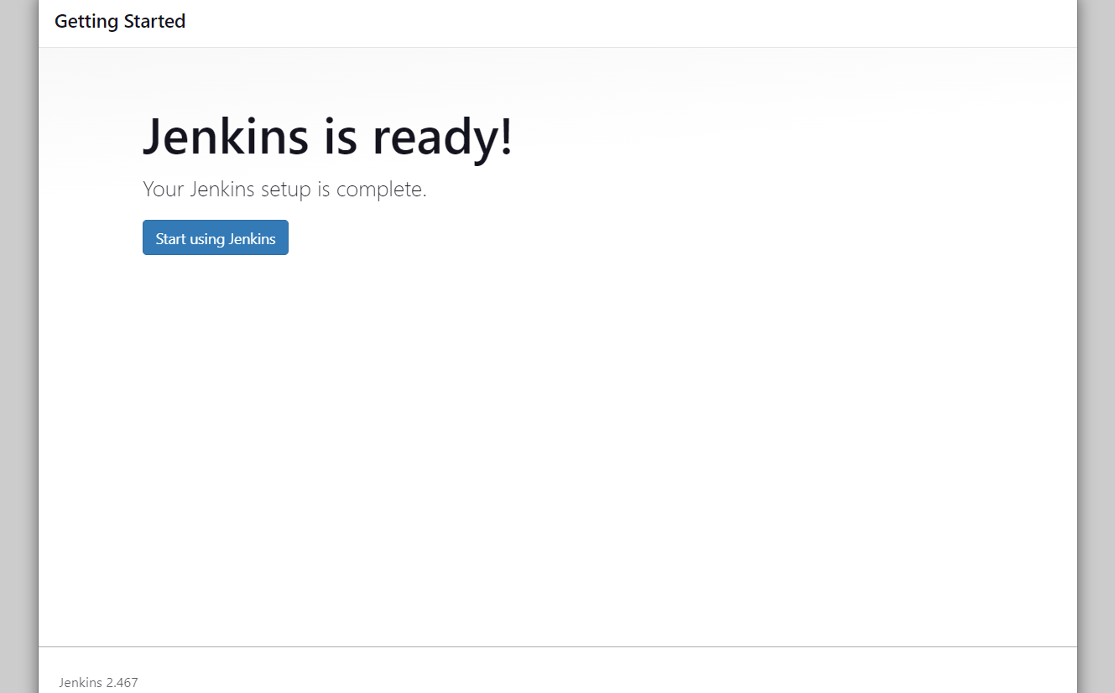
jenkins Installation is Successful. You can now starting using the Jenkins
http://:8080 [You can get the ec2-instance-public-ip-address from your AWS EC2 console page]
Note: If you are not interested in allowing All Traffic to your EC2 instance 1. Delete the inbound traffic rule for your instance 2. Edit the inbound traffic rule to only allow custom TCP port 8080
After you login to Jenkins, - Run the command to copy the Jenkins Admin Password - sudo cat /var/lib/jenkins/secrets/initialAdminPassword - Enter the Administrator password

Slide 4
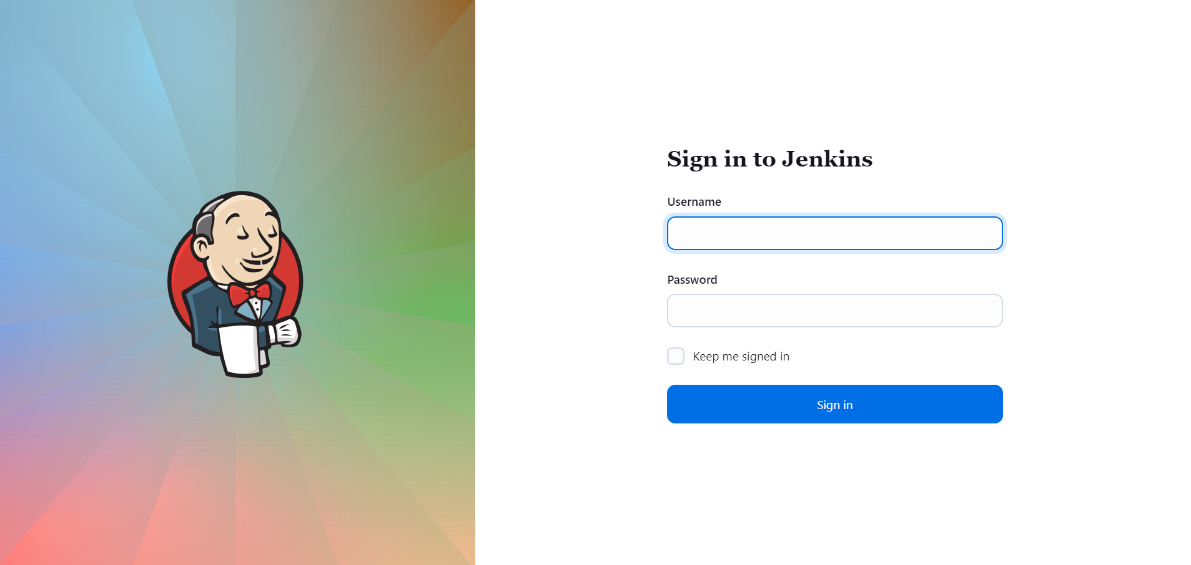
.

Slide 5
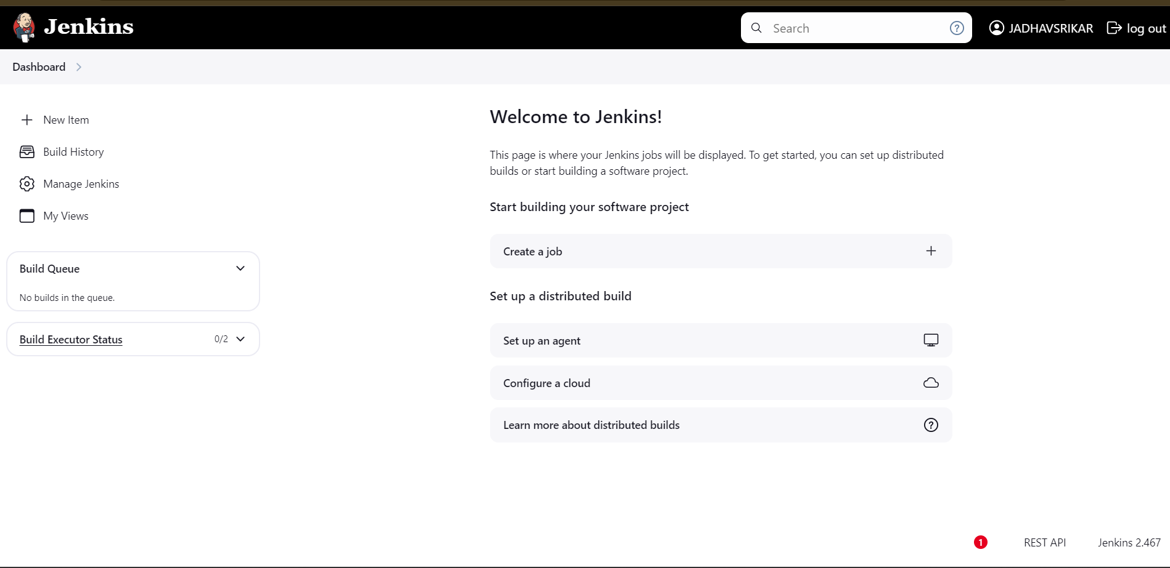
Log in to Jenkins.
Go to Manage Jenkins > Manage Plugins.
In the Available tab, search for "Docker Pipeline".
Select the plugin and click the Install button.
Restart Jenkins after the plugin is installed.

